Slide 1
New methodologies for detecting and mitigating ring0 and ring -1 exploits in modern OS
Dott. Ing. Antonio Pirozzi

Slide 2
#cat /dev/user
Unisannio Research Fellow
Cyber Security Team Leader @Koine srl
ISWATlab co-founder and Researcher
CEH
Cyber Security Evangelist and Philosopher
Vulnerability Analysist/Researcher for Emaze spa (previously)

Slide 3
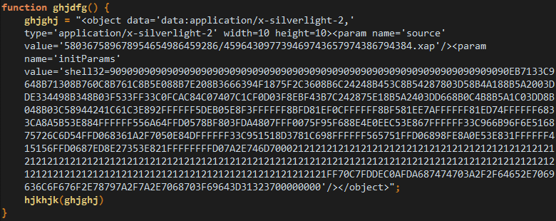
Software Vulnerability:
Introduction
The existence of a weakness, design, or implementation error that can lead to an unexpected, undesirable event compromising the security of the computer system, network, application, or protocol involved. Source: ENISA
Exploit:
Is a piece of software, a chunk of data, or a sequence of commands that takes advantage of a bug or vulnerability in order to cause unintended or unanticipated behavior.

Slide 4
Some milestones
Earliest malicious example was Morris Worm 1988 (exploited finger daemon on Unix systems)
Aleph one wrote “Smashing the stack for fun and profit” 1996 – < Early how to guide for exploiting stack buffer overflows
Code Red 2001 < Exploited buffer overflow in IIS – 359,000 hosts affected
SQL Slammer 2003 < Exploited buffer over flow in MS SQL server ~ 75,000 hosts affected
Shacham, Hovav. "The geometry of innocent flesh on the bone: Return-into-libc without function calls (on the x86)." Proceedings of the 14th ACM conference on Computer and communications security. ACM, 2007.
Buchanan, Erik, et al. "Return-oriented programming: Exploitation without code injection." Black Hat 8 (2008).
Sotirov, Alexander. "Heap feng shui in javascript." Black Hat Europe (2007).

Slide 5
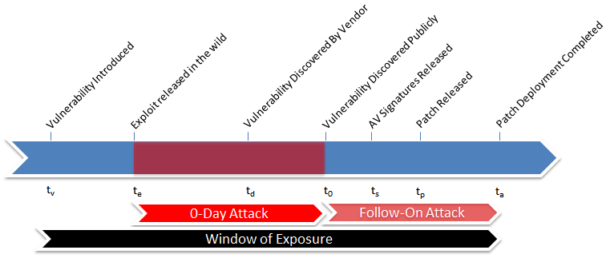
0-Day
A zero-day vulnerability is an undisclosed computer software vulnerability that can be exploited to adversely affect computer programs, data, additional computers or a network

Slide 6
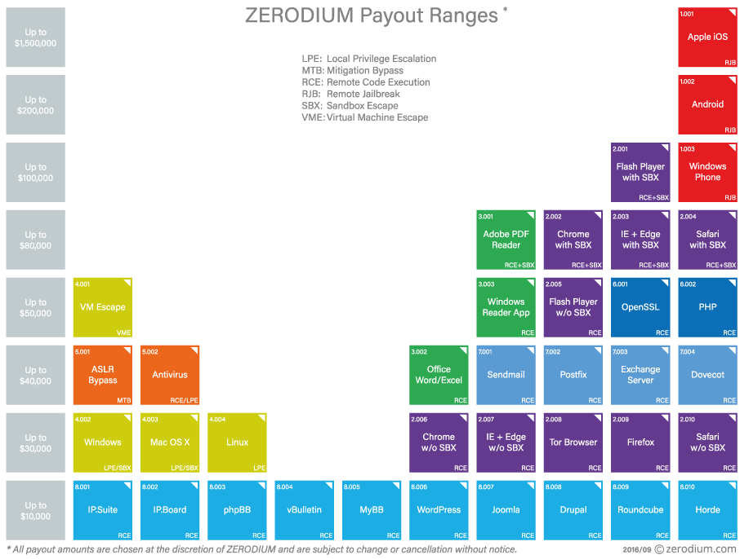
Weaponizing 0-Day

Slide 7
Weaponizing 0-Day

Slide 8
Motivation: APT
Targeted Attacks and State Sponsored Advanced Persistent Threats
Advanced
High Sofistication
Access to 0-Day Exploits
Adapt to the Victim Defence
Use Sofisticated and Low Level technIques
Fraudolent Certificate
0-Day Vulnerabilities
Centralized Command and Control
Persistent
Attacks are Specific
Continuos attacks
Intend to maintain communication with victim systems
Threats
Capability and Intents
State nation Sponsored

Slide 9
Motivation: APT
Targeted Attacks and State Sponsored Advanced Persistent Threats
Advanced
High Sofistication
Access to 0-Day Exploits
Adapt to the Victim Defence
1998 - MoonLight Maze
2003 - Titan Rain
2009 - Operation Aurora
2009 - Ghost Net
2011 - Nightdragon
2012 - Red October
2012 - Flame
2012 - Gauss
2014 - Mask
2014 - Snake
2015 - Deep Panda
Cyber Warfare
Persistent
Attacks are Specific
Continuos attacks
Intend to maintain communication with victim systems
APT
Threats
Capability and Intents
State nation Sponsored

Slide 10
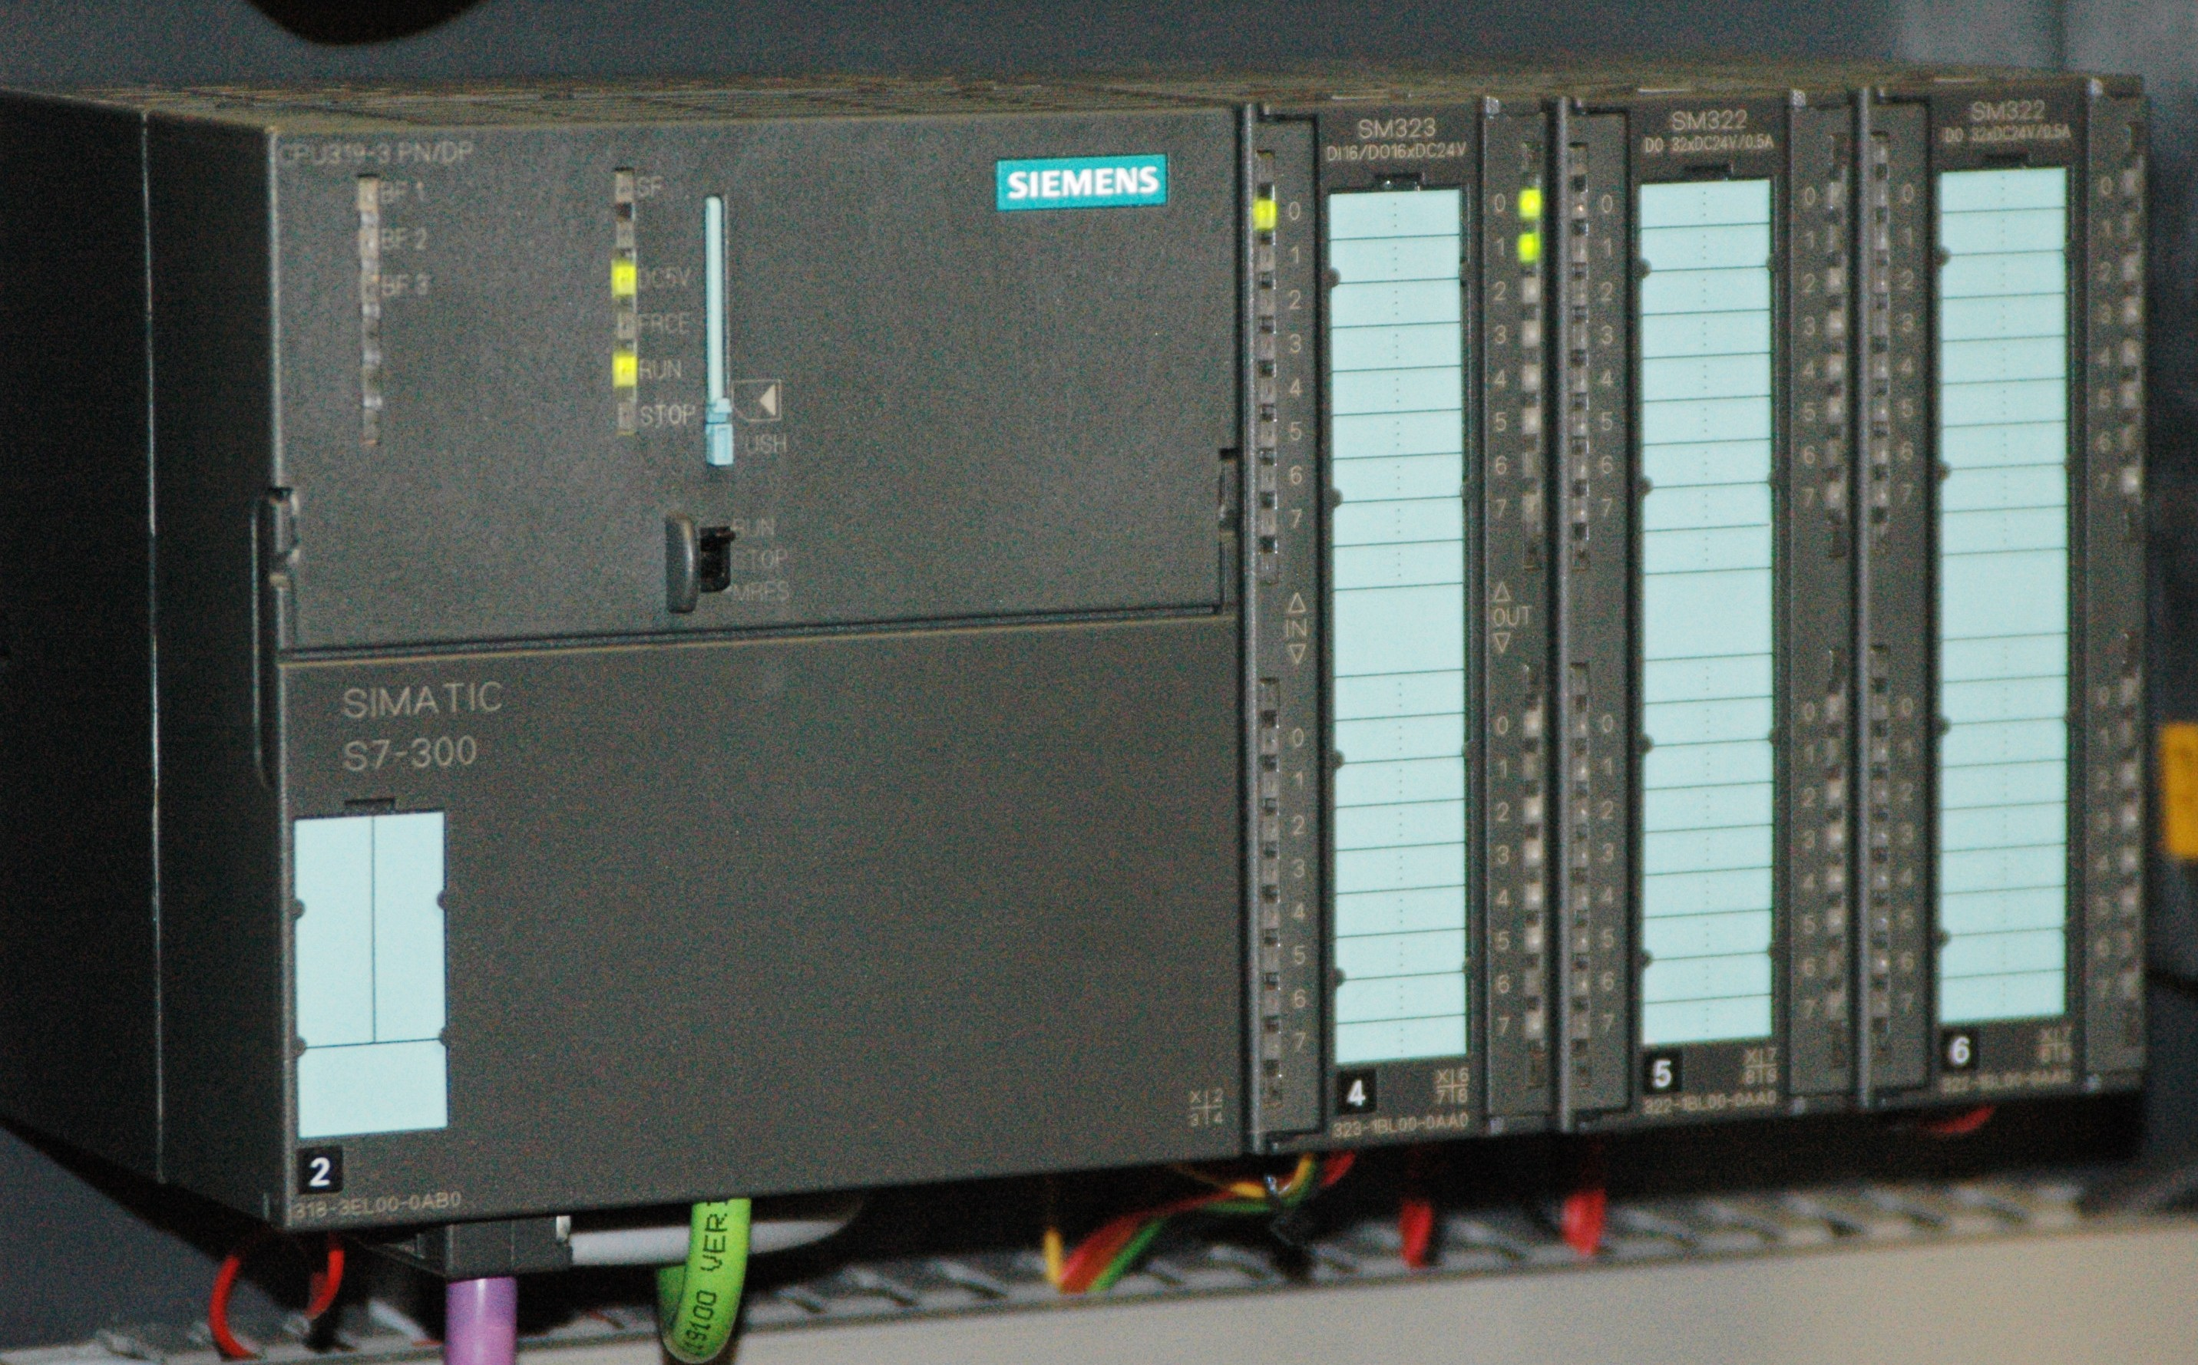
Motivation: Critical Infrastructure Threats
Sophisticated attacks on ICS systems:
Duqu2 uses a kernel mode exploit for CVE-2015-2360 to load its kernel mode component.
Turla uses 2 exploit for CVE-2013-5065 and CVE-2013-3346
Stuxnet use 4 exploit for CVE-2010-2568, CVE-2010-2729, CVE-2008-4250, CVE-2010-2722 (American-Israeli Cyber Weapon)
BlackEnergy use a memory corruption vulnerability CVE-2014-1761and an RCE vulnerability CVE-2014-4114
Stuxnet targeted Siemens S7-300. It only attacks those PLC systems with variable-frequency drives from two specific vendors: Vacon based in Finland and Fararo Paya based in Iran (spin between 807 Hz and 1210 Hz)

Slide 11
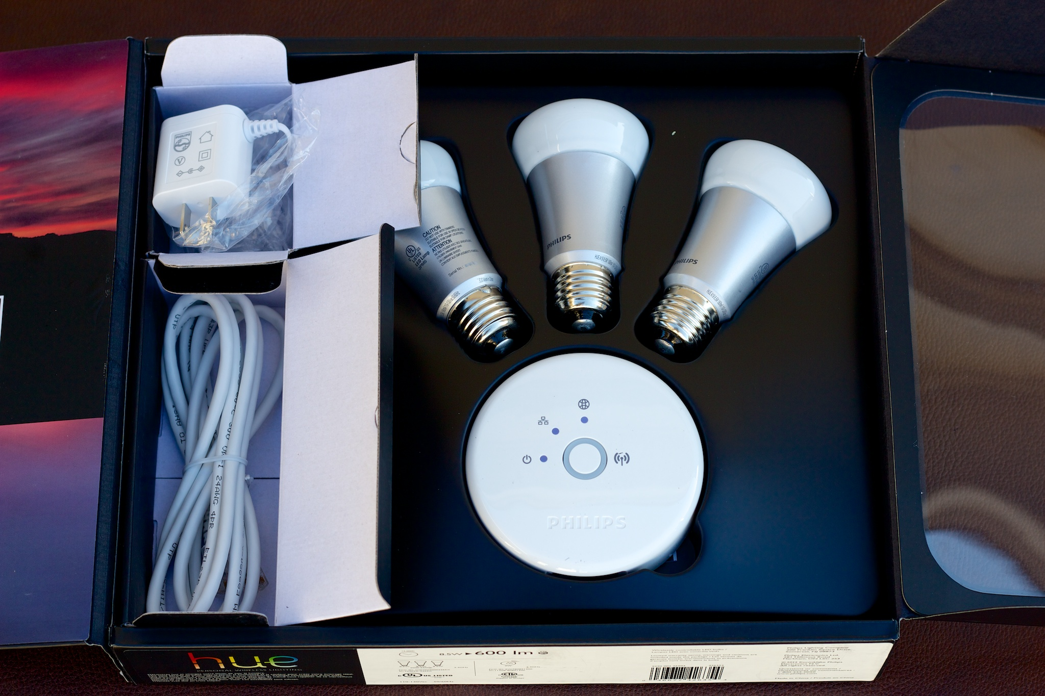
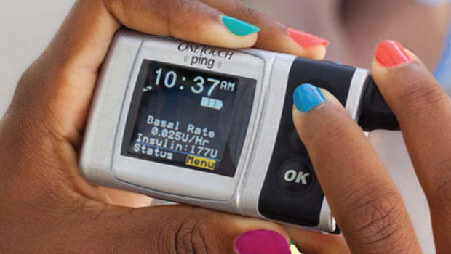
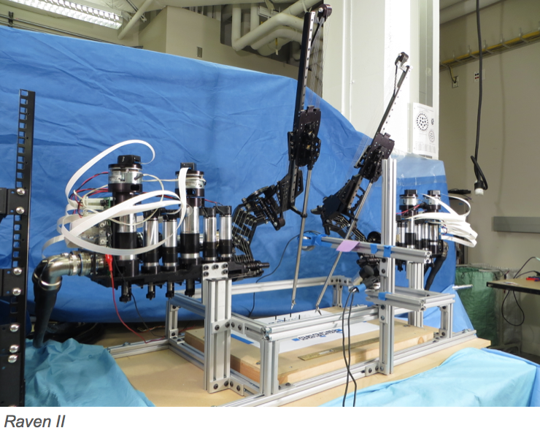
Motivation: IoT and Biomedical Threats
IoT Threats
[1] Hudson, Trammell, and Larry Rudolph. "Thunderstrike: EFI firmware bootkits for apple macbooks." Proceedings of the 8th ACM International Systems and Storage Conference. ACM, 2015.
[2] Sang, Fernand Lone, et al. "Exploiting an I/OMMU vulnerability." Malicious and Unwanted Software (MALWARE), 2010 5th International Conference on. IEEE, 2010.
[3] COLIN O'FLYNN. “ A LightBulb Worm? “, Black Hat USA 2016.
[4] CCTV-Based DDoS – Mirai Botnet
Biomedical Threats
[1] Radcliffe, Jerome. "Hacking medical devices for fun and insulin:
Breaking the human SCADA system." Black Hat Conference presentation slides. Vol. 2011.
[2] Bonaci, Tamara, et al. "To make a robot secure: an experimental analysis of cyber security threats against teleoperated surgical robots." arXiv preprint arXiv:1504.04339 (2015).

Slide 12
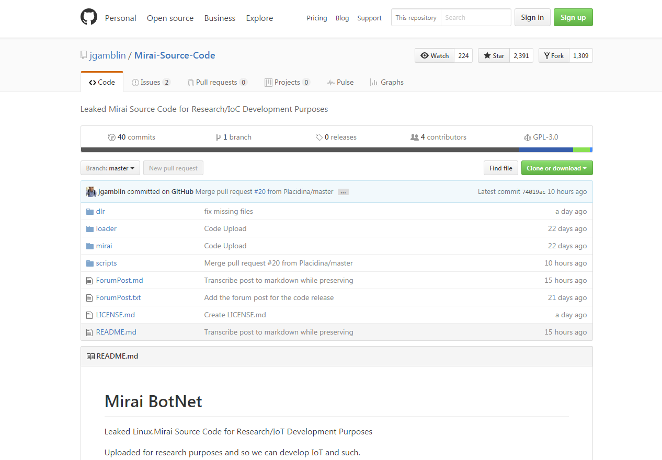
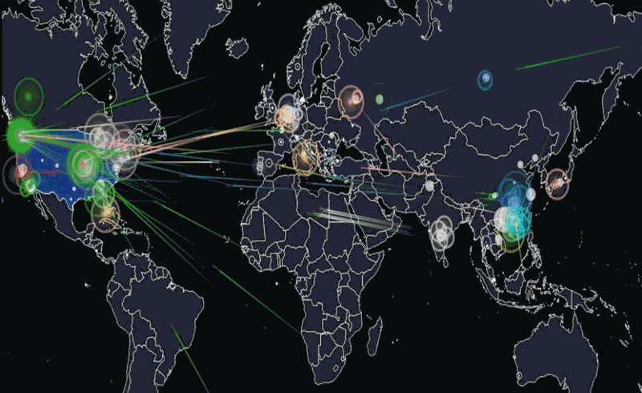
Motivation: IoT – Mirai Botnet
Source Code on Github
21 October 2016 OVH attack
The attack against Dyn was caused by tens of millions of connected things
49,657 unique IPs which hosted Mirai-infected devices
Overall, IP addresses of Mirai-infected devices were spotted in 164 countries
600 gigabits per second.

Slide 13
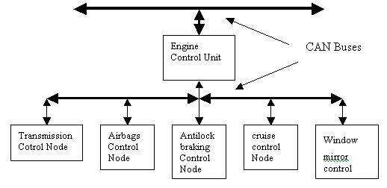
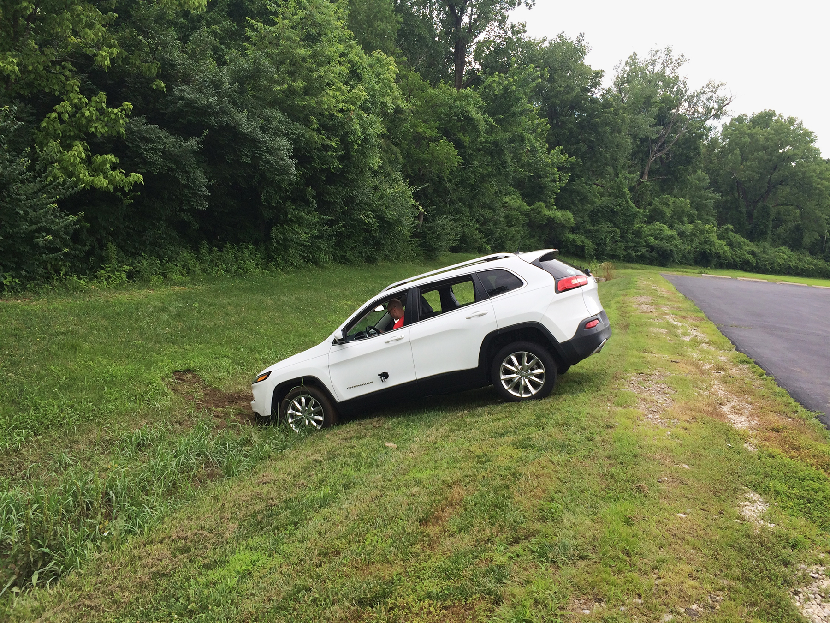
Motivation: Automotive Threats
[1] Nilsson, D. K., Larson, U. E., Picasso, F., & Jonsson, E. (2009). A first simulation of attacks in the automotive network communications protocol flexray. In Proceedings of the International Workshop on Computational Intelligence in Security for Information Systems CISIS’08 (pp. 84-91). Springer Berlin Heidelberg.
[2] Park, J., Lee, C., Park, J. H., Choi, B. C., & Ko, J. G. (2014, December). Poster: Exploiting wireless CAN bus bridges for intra-vehicle communications. In 2014 IEEE Vehicular Networking Conference (VNC) (pp. 111-112).
[3] C. Miller and C. Valasek. Remote Exploitation of an Unaltered Passenger Vehicle. In Blackhat USA, 2015.
Exploit the CAN bus
Exploit of Telematics System
Malware Exploit
OBD
Door Locks and KeyFobs
Security researchers Charlie Miller and Chris Valasek demonstrated
that they could remotely hijack a Jeep’s digital systems over the Internet

Slide 14
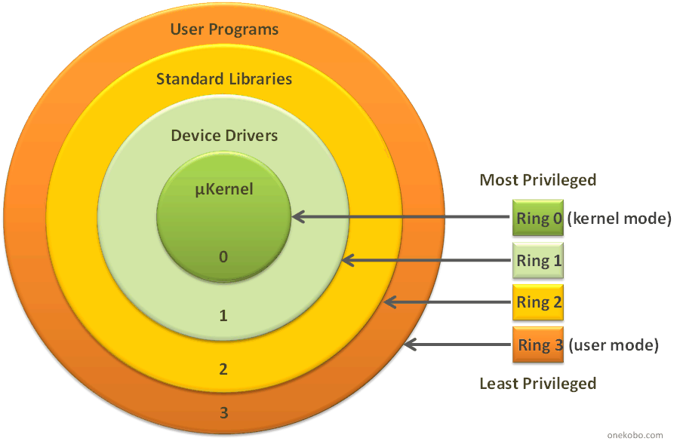
Hierarchical protection domains in modern OS
Protection rings, are mechanisms (special gates) to protect data and functionality from faults and malicious behaviours
User mode (Ring3)
No access to hardware
user mode programs has to call the system to interact with the hardware
Restricted environment, separated process
Kernel mode (Ring0)
Full access to hardware
Unrestricted access to... Everything
Kernel code, kernel structures, memory, processes, hardware

Slide 15
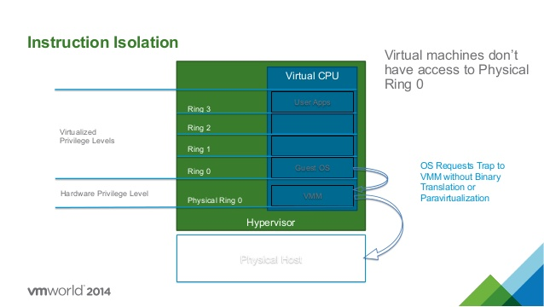
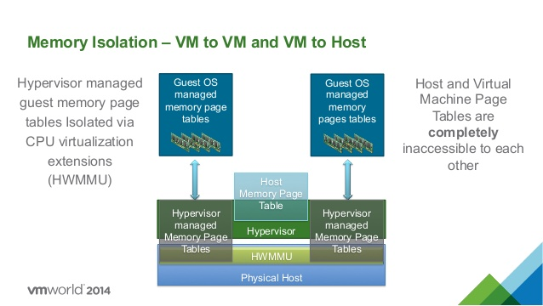
Hierarchical protection domains in modern OS: The negative rings
There are also negative rings : Ring -1
Intel VT-x (codenamed "Vanderpool") and AMD-V (codenamed "Pacifica") create a new "Ring -1"

Slide 16
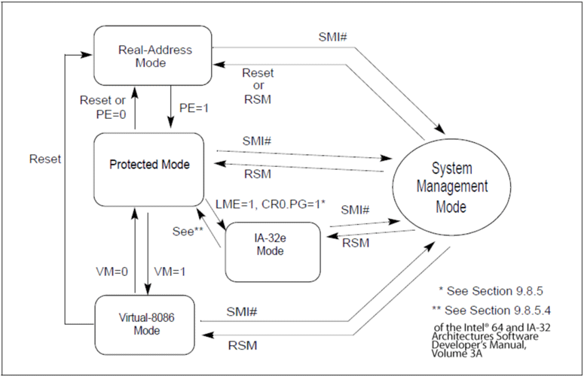
hierarchical protection domains in modern OS: The negative rings
Sistem Management module: Ring -2
SMM is the most privileged CPU operation mode on Intel architectures and facilitates power-management features and other operating-system-independent functions

Slide 17
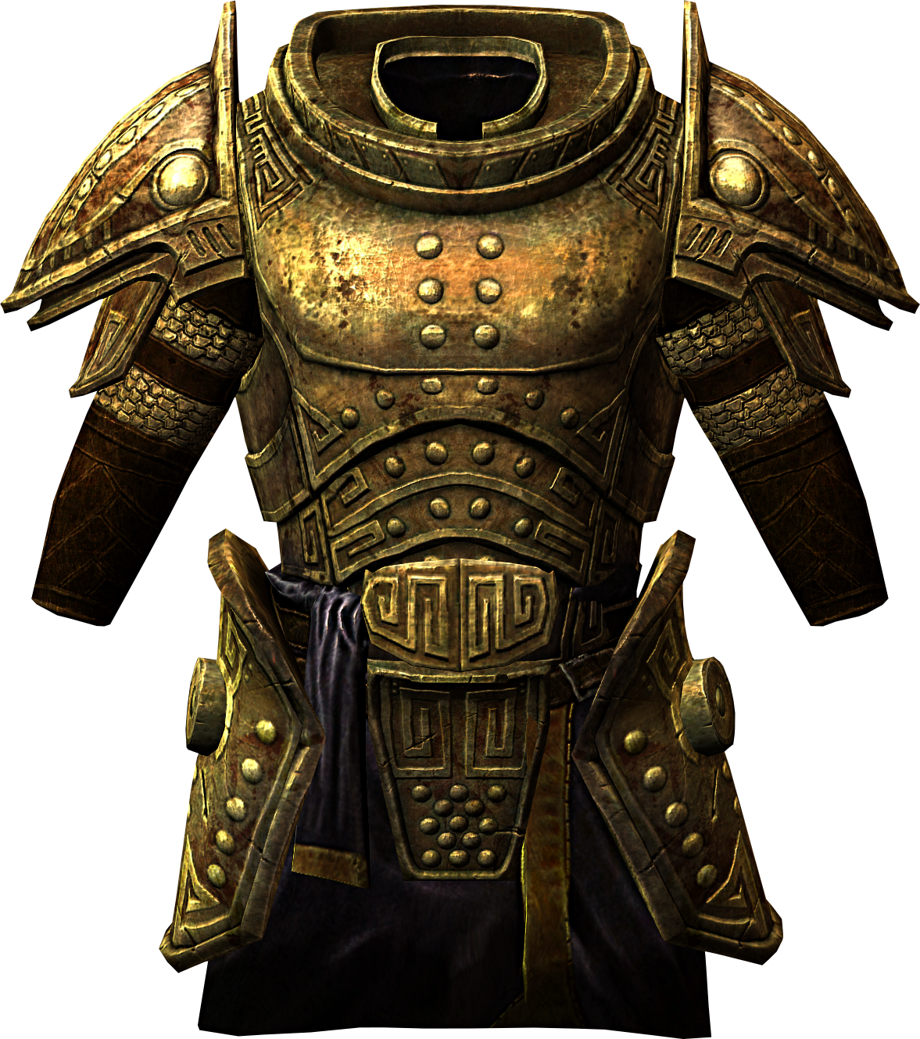
State of Art of Exploit Mitigation Technologies
Controls exist to mitigate the exploitation of software vulnerabilities
OS-Controls
Compile-Time
Heap Controls
HW Assisted
DEP, ASLR, KASLR, SMEP,SMAP, EMET
Stack Canaries, SafeSEH
Safe Unlinking, Heap entry header cookie, Heap entry metadata randomization, Null page allocation
Control Flow Integrity,
Intel TXT

Slide 18
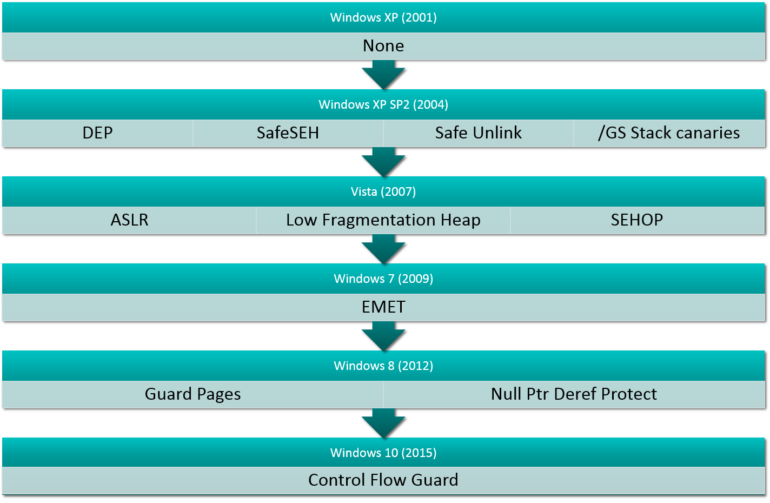
State of Art of Exploit Mitigation Technologies : Windows
Windows Exploit Mitigation Timeline

Slide 19
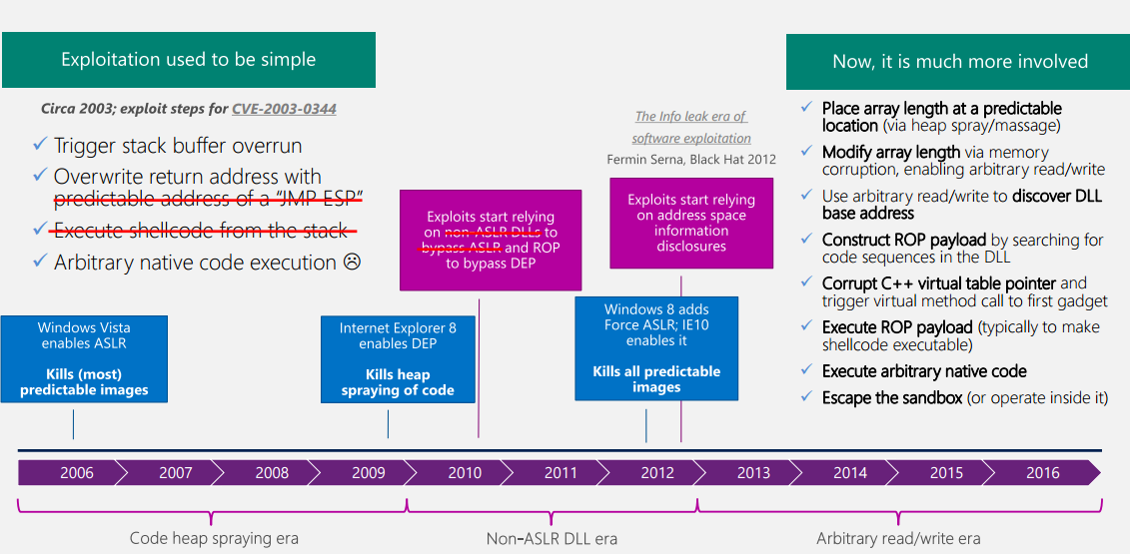
Exploit Vulnerability has become increasingly difficult
us-16-Weston-Windows-10-MitigationImprovements.pdf

Slide 20
State of Art of Exploit Mitigation Technologies : Linux
Linux Exploit Mitigation
PaX is a series of patches that can be applied to the Linux kernel. These patches provide functionality and improvements to built in features such as ASLR
Grsecurity is another series of patches that can be applied to the Linux kernel. These patches will allow changes to policy, provide a tool for RBAC
Network Protections
Executable Protections
Filesystem Protections
Memory Protections
Linux Kernel enabled a weak form of ASLR by default since the kernel version 2.6.12, released in June 2005
Position Indipendent Executable (PIE) implements a random base address for the main executable binary and has been in place since 2003

Slide 21
State of Art of Exploit Mitigation Technologies : Android – Samsung Knox
Samsung Knox

Slide 22
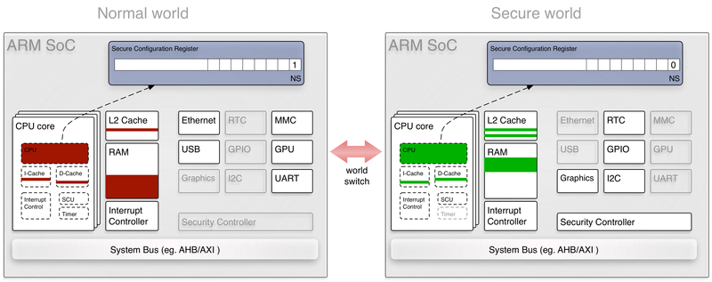
State of Art of Exploit Mitigation Technologies : TEE
ARM TRUSTZONE
When secure mode is active, the software running on the CPU has a different view on the whole system than software running in non-secure mode.
This way, system functions, in particular security functions and cryptographic credentials, can be hidden from the normal world.

Slide 23
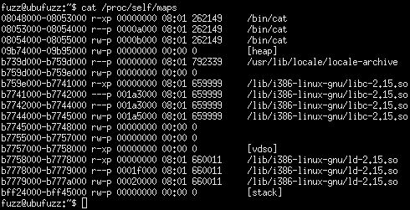
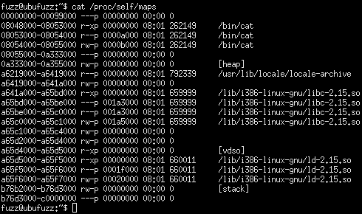
State of Art of Exploit Mitigation Technologies : ASLR - KASLR
ASLR
ASLR randomly arranges the address space positions of key data areas of a process, including the base of the executable and the positions of the stack, heap and libraries
KASLR currently randomizes where the kernel code (i.e. text) is placed at boot time.
ASLR with Grsecurity

Slide 24
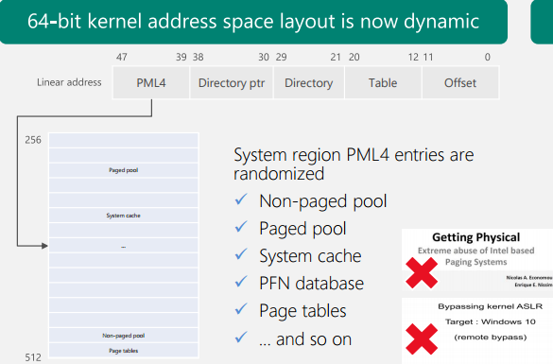
State of Art of Exploit Mitigation Technologies : Windows Kernel 64 bit ASLR
Page table self-map and PFN database are randomized
SIDT/SGDT kernel address disclosure is prevented when Hyper-V is enabled
GDI shared handle table no longer discloses kernel addresses

Slide 25
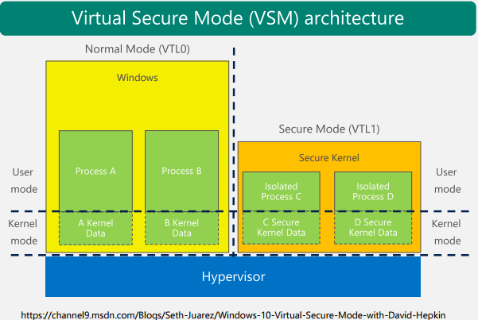
State of Art of Exploit Mitigation Technologies : Windows 10 VBS (kernel)
Hyper Guard
Prevents modification of key MSRs, control registers, and descriptor table register. Example: SMEP cannot be disabled
Hypervisor-Enforced Code Integrity (HVCI)
Only properly signed kernel pages can become executable

Slide 26
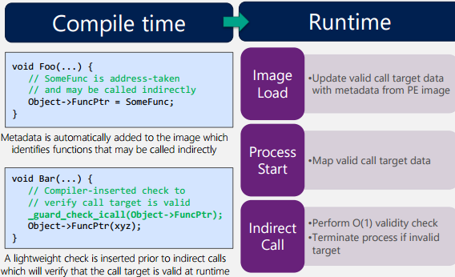
State of Art of Exploit Mitigation Technologies : Control Flow Guard (CFG)
Control Flow Hijack via indirect call to ROP gadget
CFG implement coarse grained control-flow integrity for indirect calls

Slide 27
Evaluation of actual Exploit Mitigation Technologies 1/3
Incomplete Memory Protection
Advanced Memory Attack Techniques (Flash JIT Spraying)
[1] Blazakis, Dion. "Interpreter exploitation: Pointer inference and JIT spraying."BlackHat DC (2010).
Evade DEP and ASLR
New Exploit Kit are Sophisticated
Evade EMET, EAF and EAF+
[1] Angler Exploit Kit
EMET Defeated
[1] Jalayeri, Shahriyar. "Bypassing EMET 3.5’s ROP mitigations." REP RET Reversing, Exploiting and Nt adventure. Blog (2012).
[2] Piotr Bania "Bypassing EMET Export Address Table Access Filtering feature“ (2014)
[3] Abdulellah Alsaheel and Raghav Pande, “Using EMET to Disable EMET”
Bypassing EMET 3.5 ROP mitigation
Bypassing EMET Export Address Table Access Filtering feature
Evade EMET 5.2

Slide 28
Evaluation of actual Exploit Mitigation Technologies 2/3
Incomplete Kernel Protection
Side Channel Attacks on Kernel:
[1] Gruss, Daniel, et al. "Prefetch Side-Channel Attacks: Bypassing SMAP and Kernel ASLR." Proceedings of the 23rd ACM Conference on Computer and Communications Security (CCS). 2016.
Bypassing SMAP and KASLR
Ret2usr Attack
[2] Kemerlis, Vasileios P., Michalis Polychronakis, and Angelos D. Keromytis. "ret2dir: Rethinking kernel isolation." 23rd USENIX Security Symposium (USENIX Security 14). 2014.
Bypassing SMEP, SMAP, PXN, KERNEXEC,
UDEREF, and kGuard
SMEP Defeated
[3] SHISHKIN, ARTEM. "Intel SMEP overview and partial bypass on Windows 8.“
Bypassing SMEP
KASLR Defeated
[4] Using Undocumented CPU Behaviour to See into Kernel Mode
and Break KASLR in the Process” Anders Fogh and Daniel Gruss, BlackHat US 2016 August 4, 2016
Bypassing KASLR

Slide 29
Evaluation of actual Exploit Mitigation Technologies 3/3
Exploiting ARM TrustZone
[1] Shen, Di. "Exploiting Trustzone on Android." Black Hat conference. 2015.
[2] Full TrustZone exploit for MSM8974 (http://bitsplease.blogspot.it/2015/08/full-trustzone-exploit-for-msm8974.html)
Exploiting Samsung Knox
[1] KNOXout (a.k.a CVE-2016-6584) (bypass the RKP protections and to execute code in the system user context)
[2] CVE-2016-3996] has also been successful on KNOX 2.3, running on Android 5.0

Slide 30
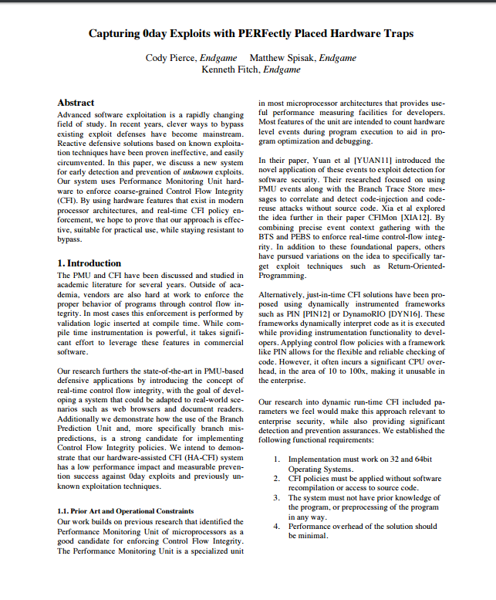
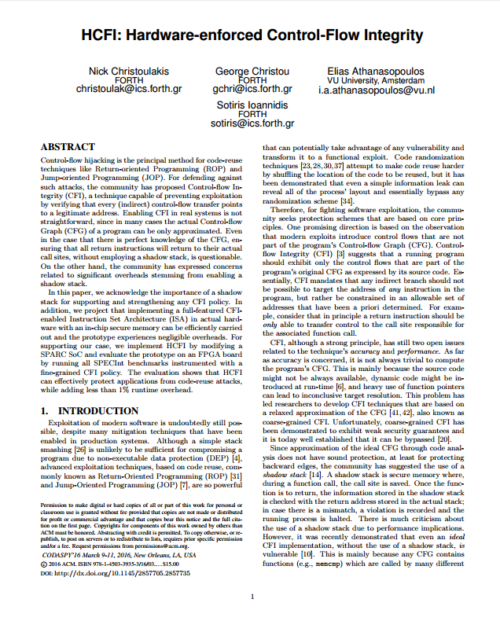
Some exploits mitigation efforts in literature
Pappas, Vasilis, Michalis Polychronakis, and Angelos D. Keromytis. "Transparent ROP exploit mitigation using indirect branch tracing." Presented as part of the 22nd USENIX Security Symposium (USENIX Security 13). 2013.
Capturing 0day Exploits with PERFectly Placed Hardware Traps, Cody Pierce, Endgame Matthew Spisak, Endgame Kenneth Fitch, Endgam, Black Hat US 2016
Christoulakis, Nick, et al. "HCFI: Hardware-enforced Control-Flow Integrity."Proceedings of the Sixth ACM Conference on Data and Application Security and Privacy. ACM, 2016.

Slide 31
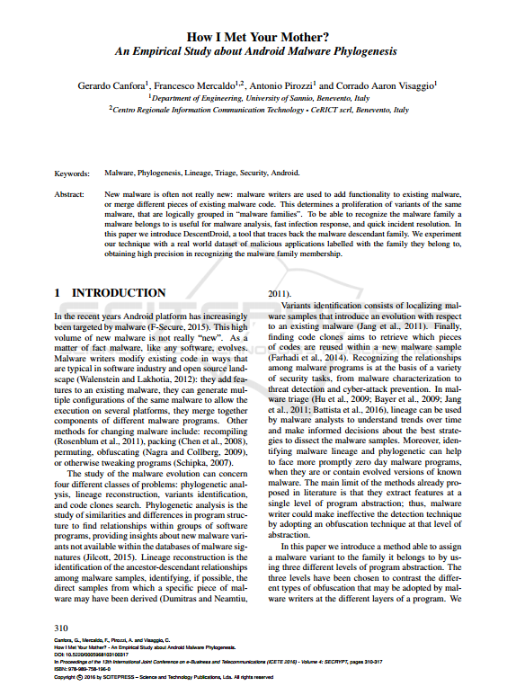
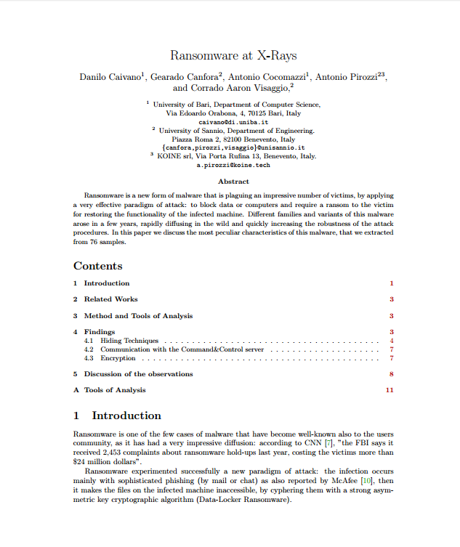
Exploit and Malware Analysis
Gerardo Canfora, Francesco Mercaldo, Antonio Pirozzi, Corrado Aaron Visaggio: How I Met Your Mother? - An Empirical Study about Android Malware Phylogenesis. SECRYPT 2016
Ransomware at X-Rays , Danilo Caivano , Gearado Canfora , Antonio Cocomazzi, Antonio Pirozzi , and Corrado Aaron Visaggio,

Slide 32
Research Goals
Three Assumptions:
Exploit mitigation technologies aim to reduce attack Surface
Increasing the cost of exploit development
Modern exploitation techniques are rapidly changing
Research Goals:
Define computation models based on exploit taxonomy
Define new exploit mitigation techniques based on these models
Implement these techniques in two possible way: HW assisted or SW assisted
Evaluate the effectiveness of the proposed solutions

Slide 33
Research Agenda: Experimentations
In a Controlled Environment
Create syntetic scenarios
Working with emulators (es. HW assisted emulation with new defined ISA, QEMU)
Goals:
Preliminary tuning of the solutions
Identifying fine/grain errors or defects of the solution
On real system
Goals:
Evaluate the properties of the solution effectiveness, efficacy, scalability
Preparing the research prototype to the industrialization

Slide 34
Research Agenda : the Research Loop
Systematic review of the literature itaration allong the overall period
Definition of the methodology
Identification of the problem(s)
Methods
Techniques
Algorithms
Software tool
Experimentation
Design
Execution
Data collection
Results Analysis ^ solution improvement

